Slide 1
Project Presentation of CO-OP Project at Industry (Module-2) (22CS421)
On
Optimizing Data Ingestion Pipelines for Efficient Big Data Processing
Akshat Garg
2210990086
Supervised By
Rajat Takkar
Department of Computer Science and Engineering,
Chitkara University, Punjab

Slide 2
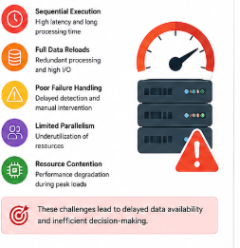
Problem & Motivation
Challenges in Traditional Pipelines:
Sequential execution → High latency
Full data reload → Redundant processing
Poor failure handling
Limited parallelism
Impact:
Delayed data availability
Inefficient resource usage
Poor decision-making
2

Slide 3
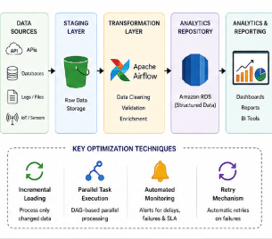
Proposed Solution
Optimized Pipeline Approach:
Incremental Data Loading
Parallel Task Execution (DAG-based)
Automated Monitoring & Alerts
Retry Mechanism for failures
Tools Used:
Apache Airflow (Orchestration)
Apache Kafka (Streaming)
Amazon RDS (Storage)

Slide 4
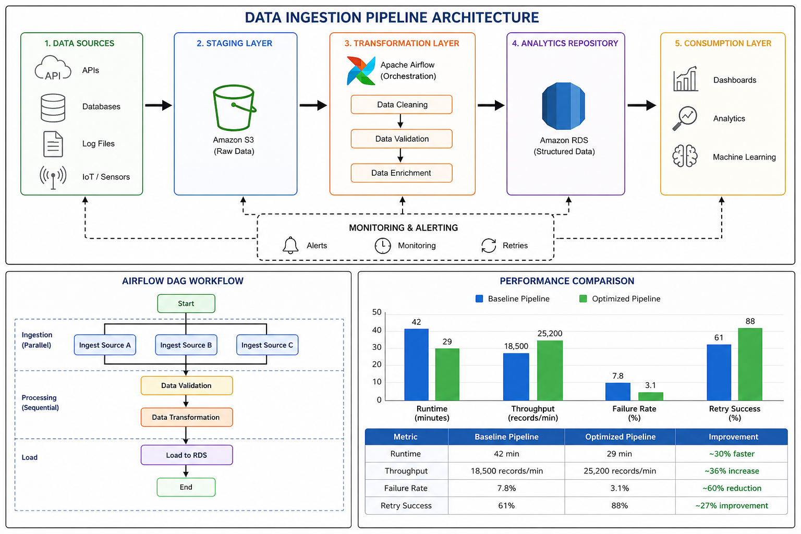

Slide 5
Results & Improvements
Key Insights:
~30% faster execution
Higher throughput
Improved reliability
Metric | Baseline Pipeline | Optimized Pipeline
Average Runtime | 42 min | 29 min
Throughput | 18,500 records/min | 25,200 records/min
Failure Rate | 7.8% | 3.1%
Retry Recovery Success | 61% | 88%

Slide 6
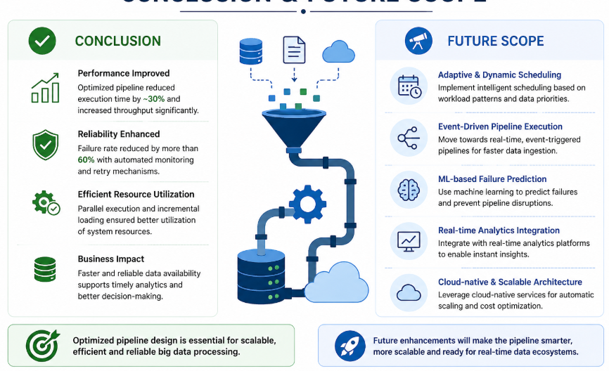
Conclusion & Future Scope
Conclusion:
Workflow design > infrastructure
Parallelism + incremental loading improves efficiency
Reliable pipelines enable better analytics
Future Scope:
Event-driven pipelines
ML-based failure prediction
Real-time data processing

Slide 7
Thank You
7

